Slide 1
CRAFTIFY
ANJANA GOPAN K Assistant Prof.HUSAIN AHAMED
MCA, Semester VI Department of Computer Application
Government Engineering College, Thrissur
Mini Project Third Review, 2022
1/20

Slide 2



Outline
1
INTRODUCTION
2
EXISTING SYSTEM
3 PROPOSED SYSTEM
4
WORK DONE
5 ADMIN MODULE
6
SELLER MODULE
2/20

Slide 3
INTRODUCTION
CRAFTIFY is an Ecommerce Business Application to support sellers and customers for selling and buying of craft products as well as the accessories.
It also promotes tutors for online teaching of making crafts. It also provides an opportunity for an online photo exhibition.
Tutorials will be provided free for 7 days, continue to access the tutorials only after subscribe the applications
INTRODUCTION
3/20

Slide 4
EXISTING SYSTEM
The existing system is not efficient, and no opportunities for online tutors. There is no option for an online photo exhibition
EXISTING SYSTEM
4/20

Slide 5
PROPOSED SYSTEM
Overcome all the drawbacks of Existing system
Proposed system consists of mainly three modules, they are:
ADMIN SELLER CUSTOMER
PROPOSED SYSTEM
5/20

Slide 6
Admin Module Completed Seller Module Completed
WORK DONE
WORK DONE
6/20

Slide 7
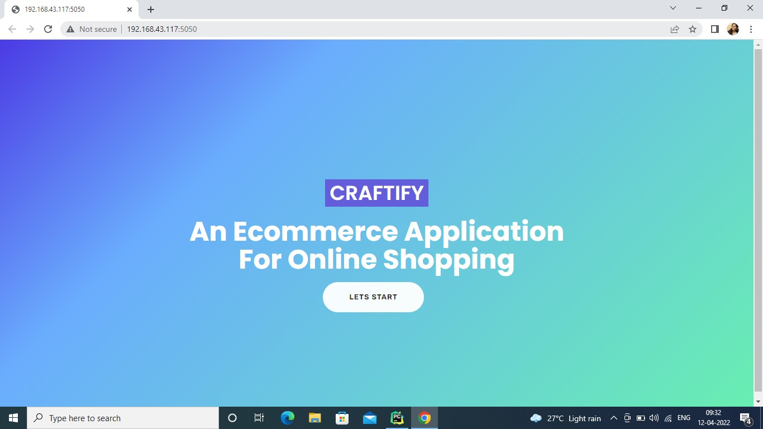
ADMIN MODULE
ADMIN MODULE
7/20

Slide 8
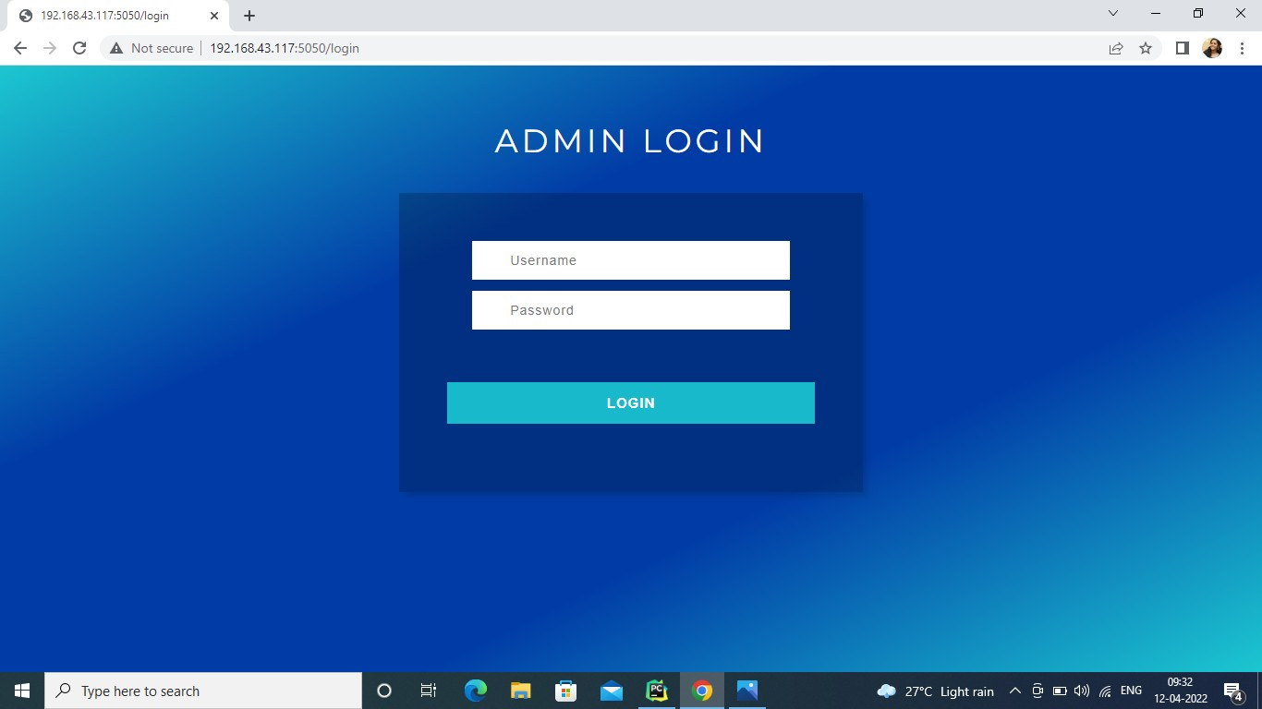
ADMIN MODULE

Slide 9
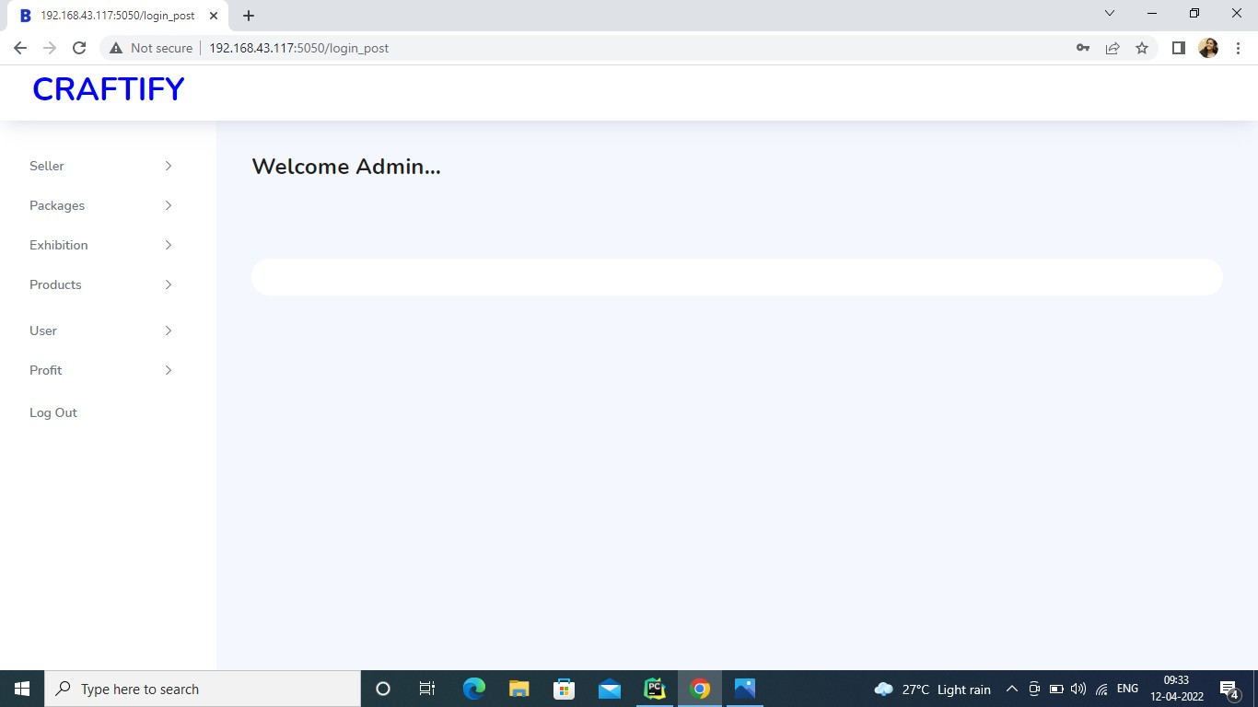
ADMIN MODULE

Slide 10
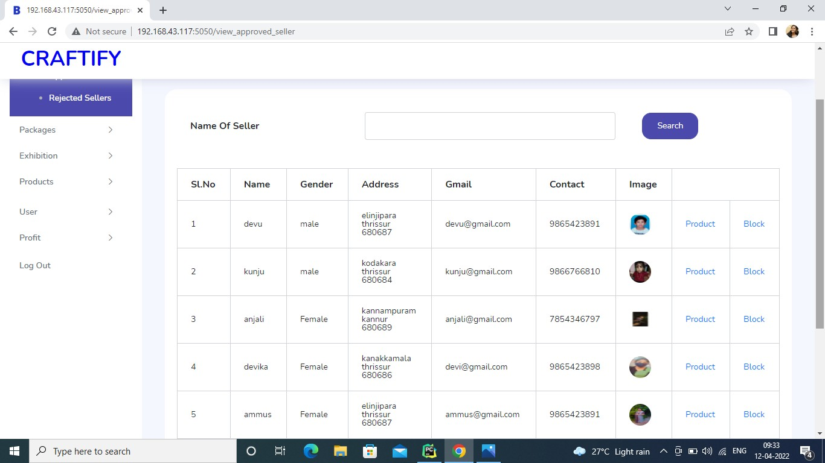
ADMIN MODULE

Slide 11
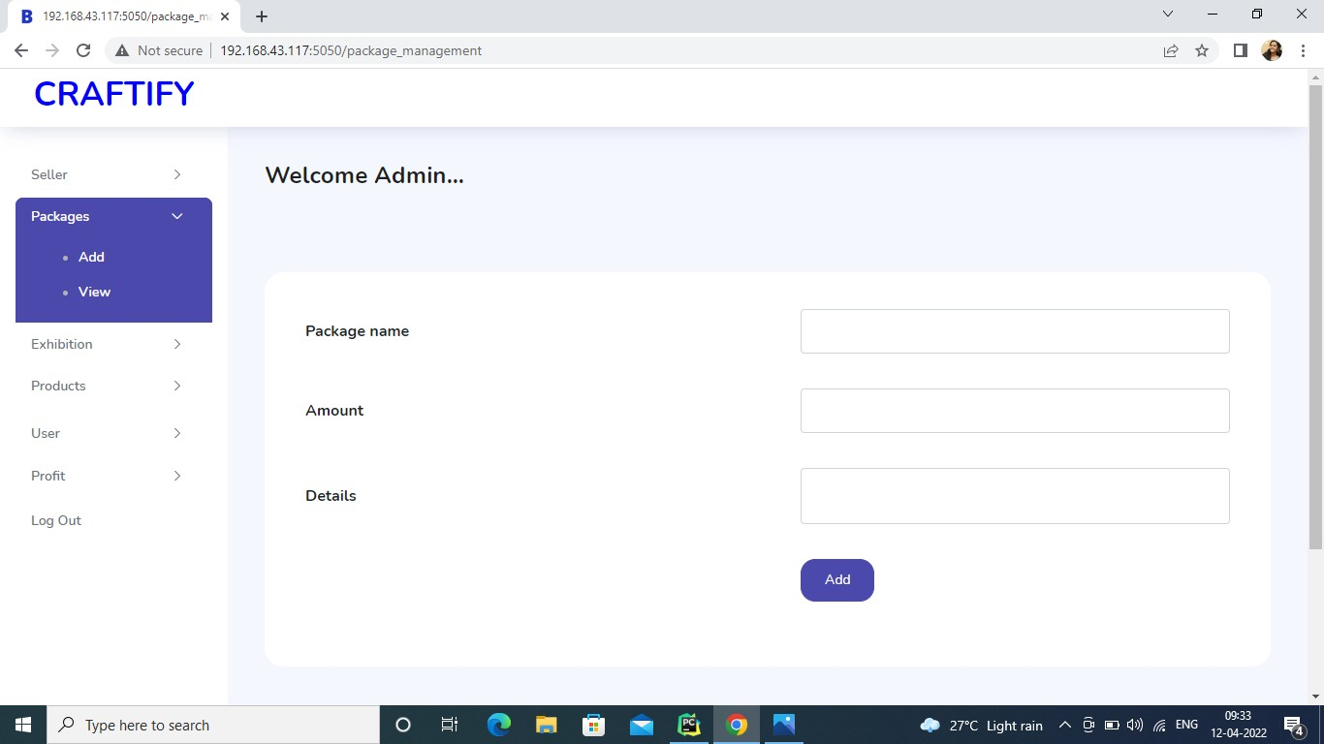
ADMIN MODULE

Slide 12
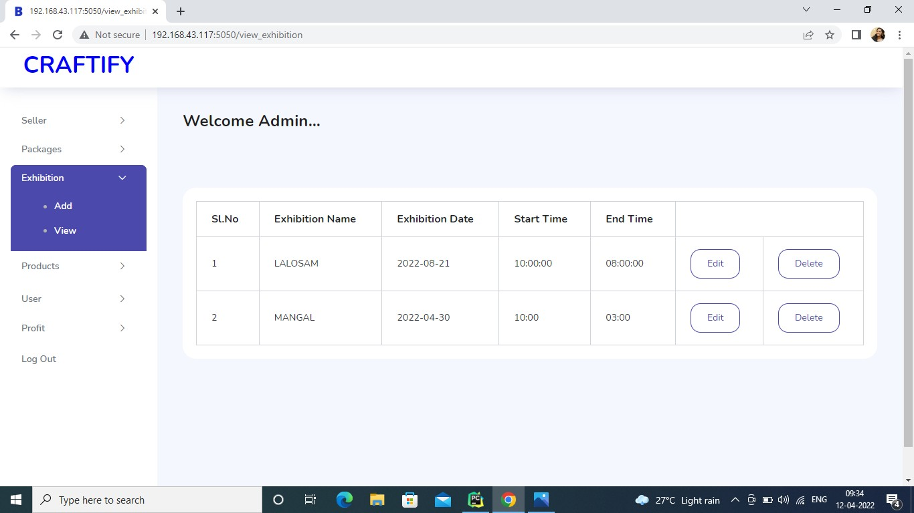
ADMIN MODULE

Slide 13
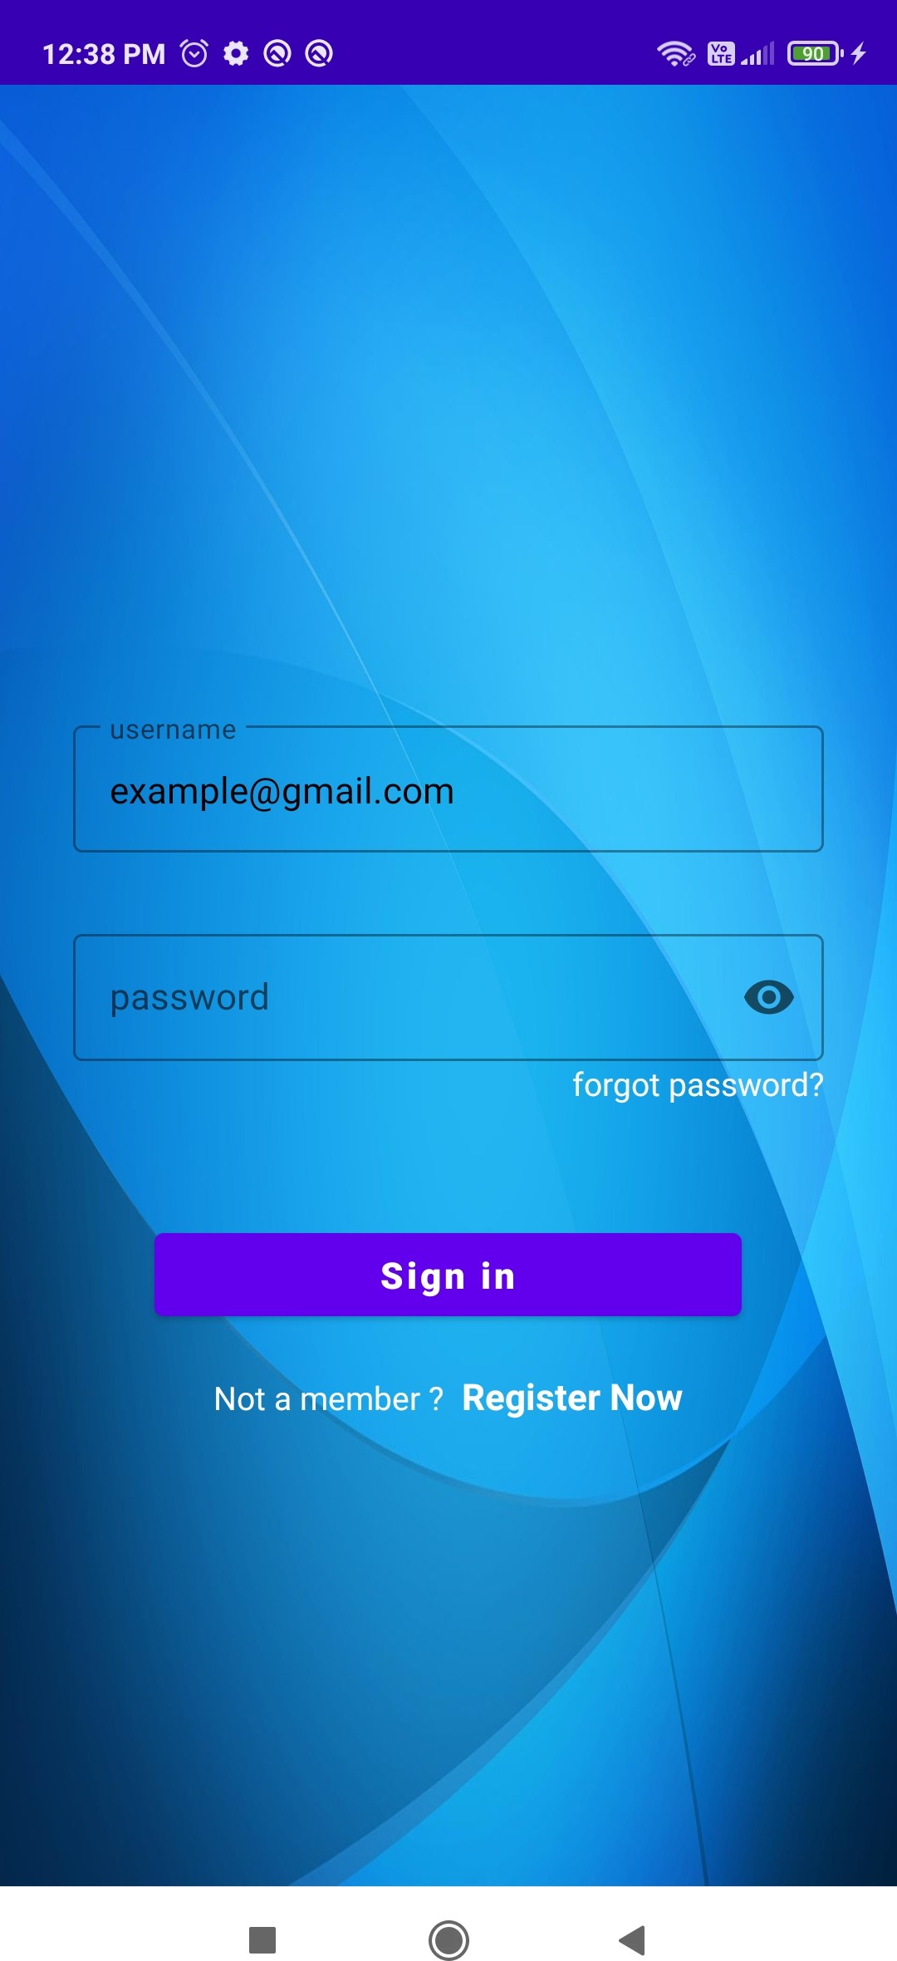
SELLER MODULE
SELLER MODULE

Slide 14
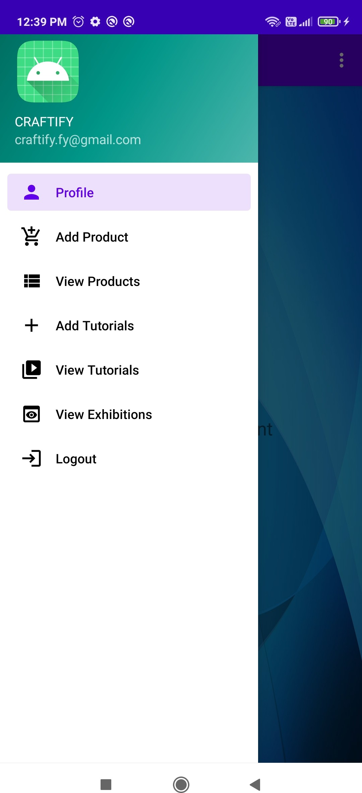
SELLER MODULE

Slide 15
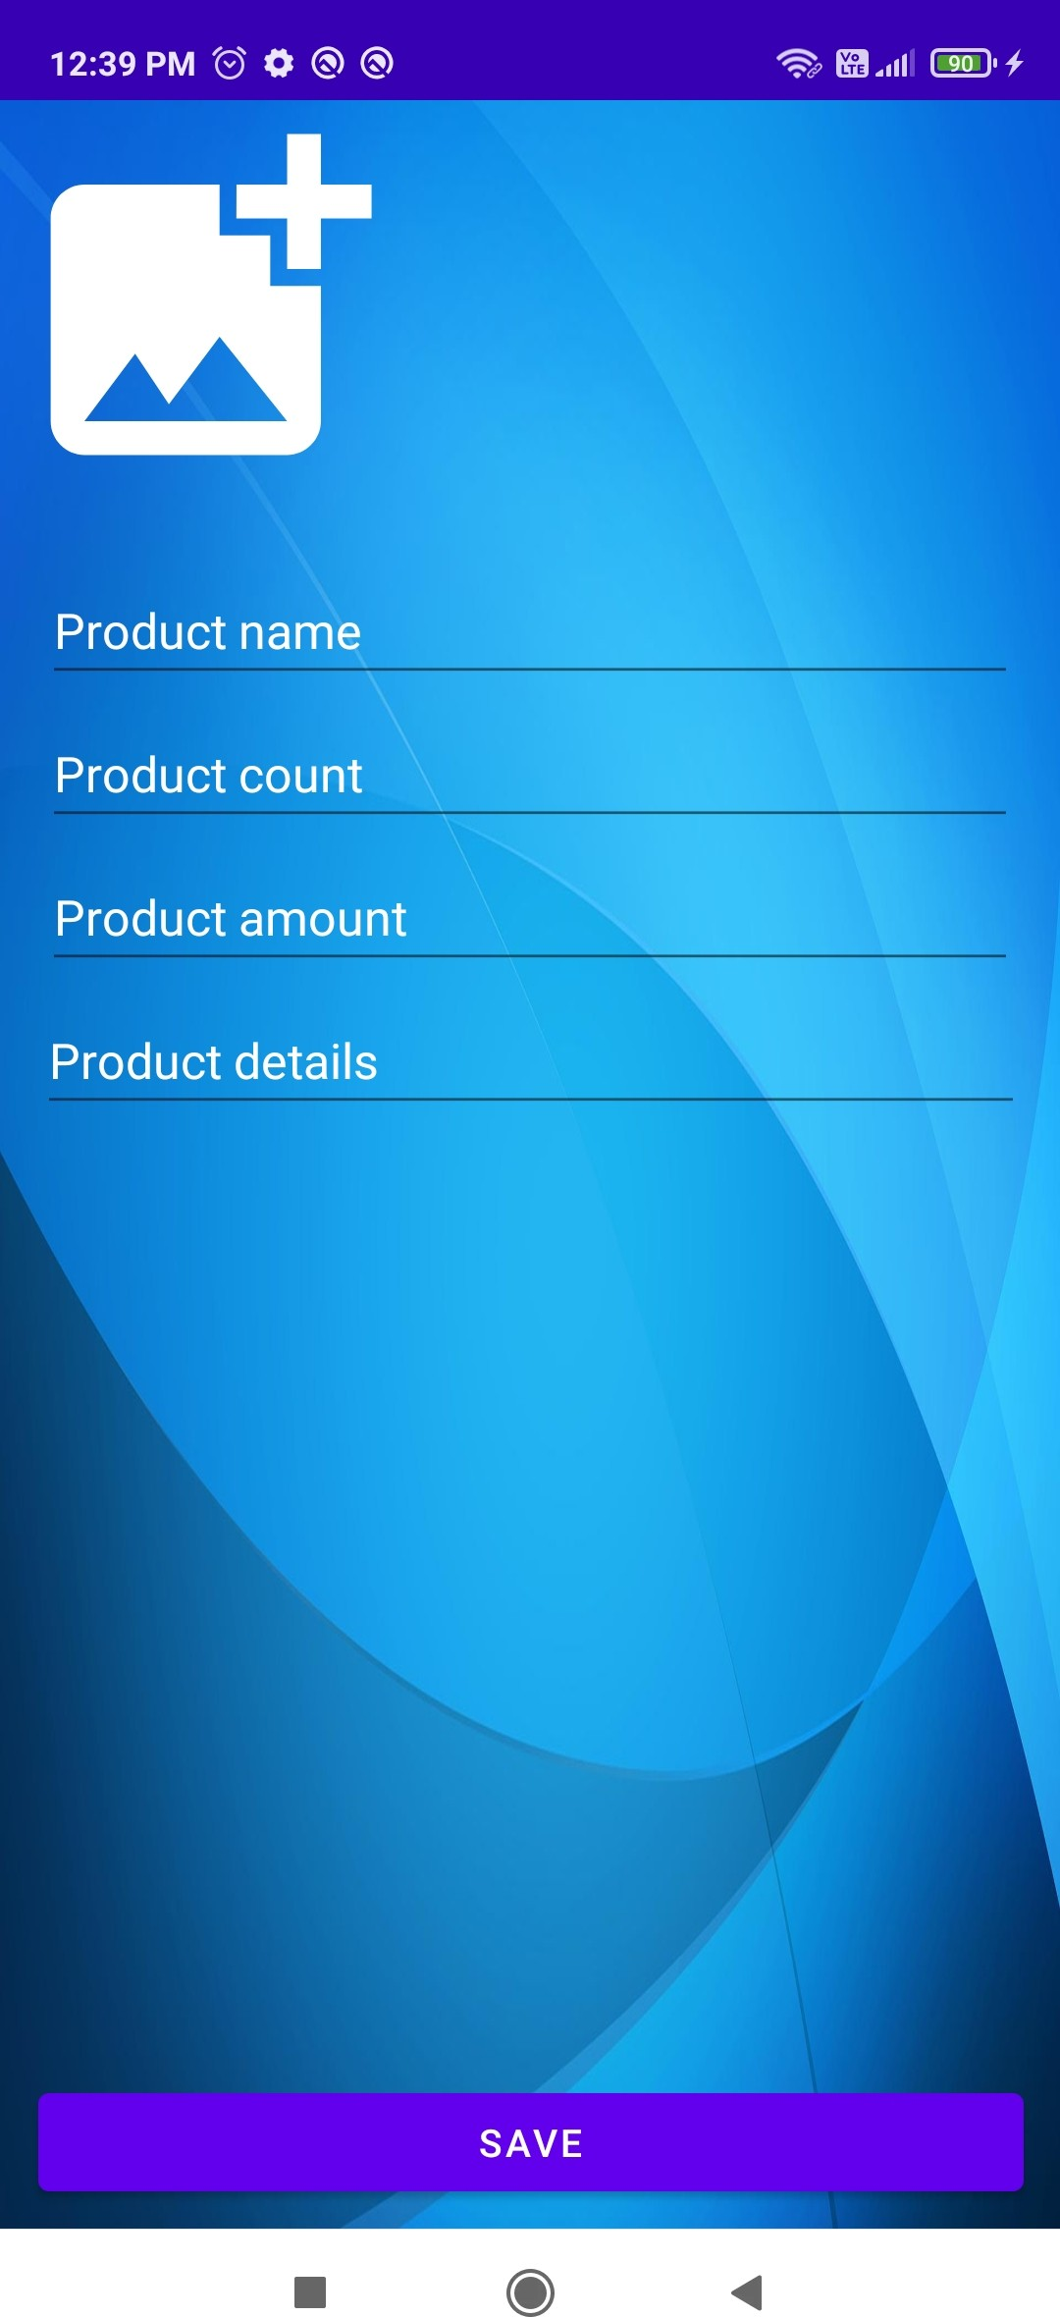
SELLER MODULE

Slide 16
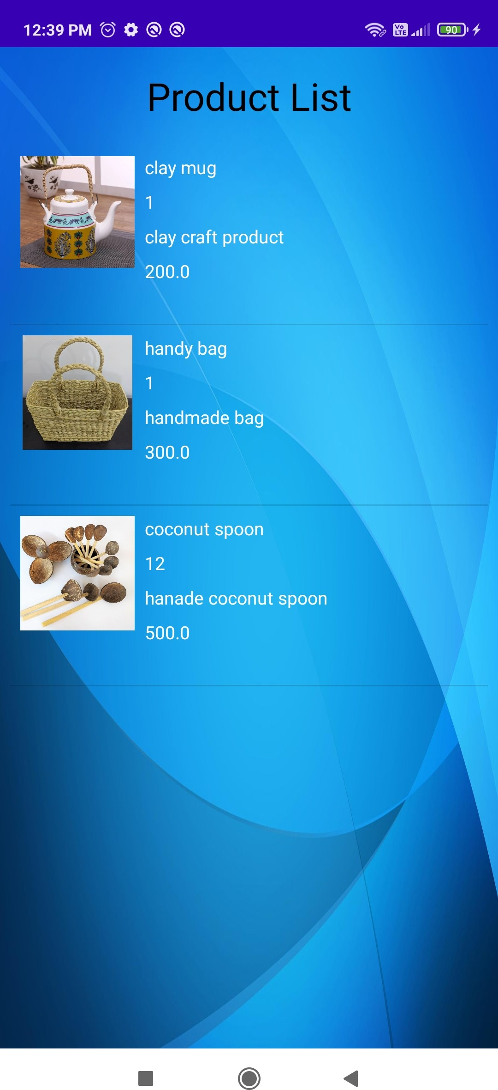
SELLER MODULE

Slide 17
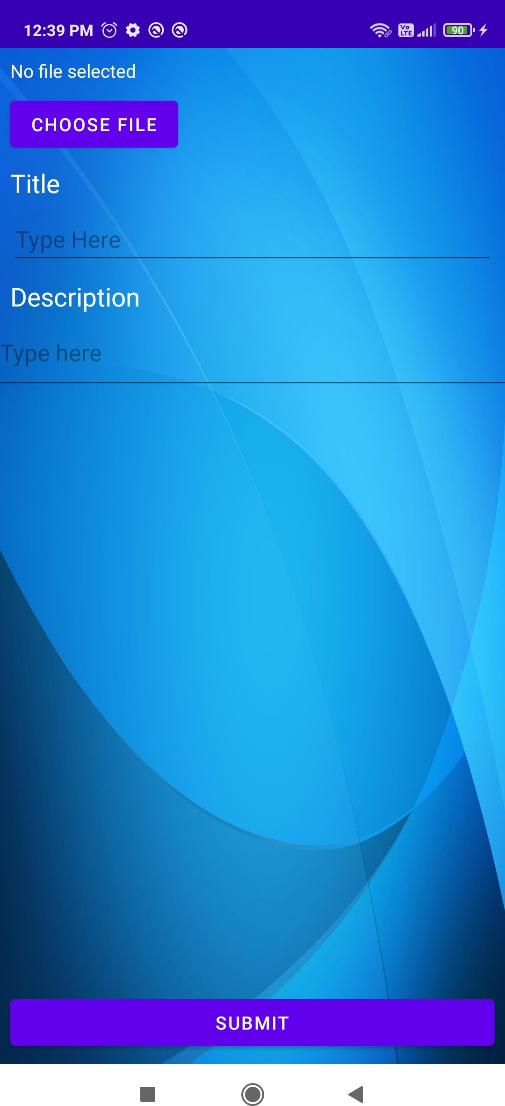
SELLER MODULE

Slide 18
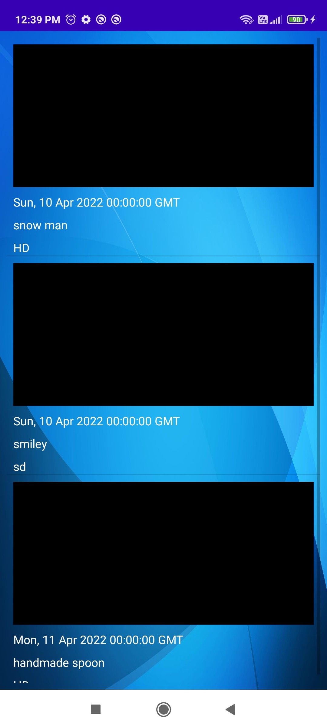
SELLER MODULE

Slide 19
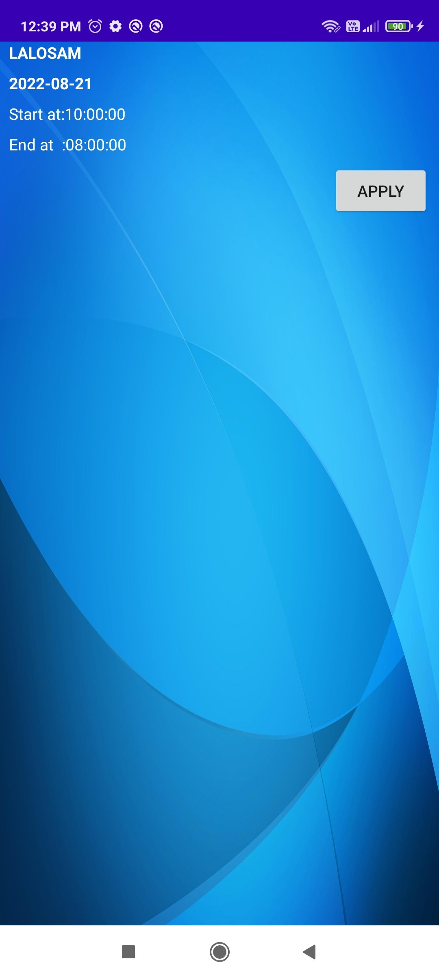
SELLER MODULE

Slide 20
THANK YOU
THANKS

